Slide 1


POLICIES AND PROCEDURES
Revised 04/28/2025

Slide 2

OVERVIEW AND PURPOSE
This training will provide employees in the Food Service Division with information on the policies and procedures of both the Division and the District.
The purpose is to protect the health and safety of all:
    Employees
    Students
    Members of the public

Slide 3
OBJECTIVES
Discuss and highlight key Division and District policies and procedures.
  This training does not encompass all Division and District policies and procedures
  Regularly check both the LAUSD and Food Services Division websites for policy updates
It is the responsibility of all employees to know all policies and procedures.

Slide 4

DRESS CODE POLICY

Slide 5

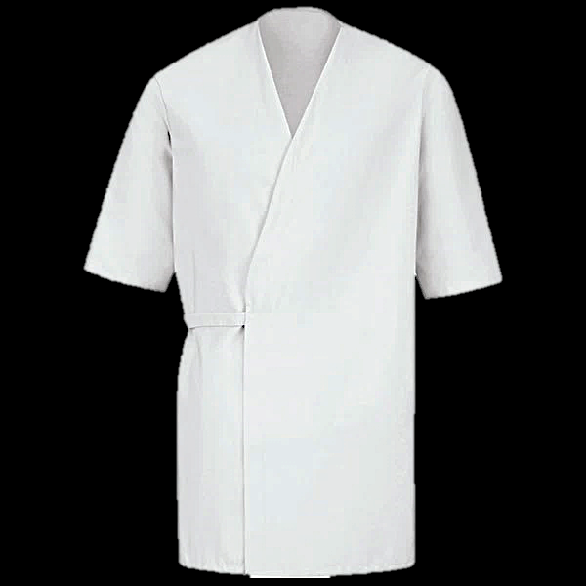



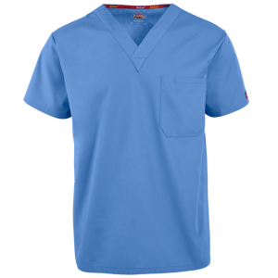
TOPS
Food Services Division (FSD) employees must always comply with the Division’s Dress Code Policy during their regular assigned hours. Employees may wear a proper-fitting collared shirt or a nurse’s scrub.
Polo Shirt
Smock
Nurse Scrubs
    If Friday is spirit day, employees may wear the official Spirit Day shirt for the school.

Slide 6
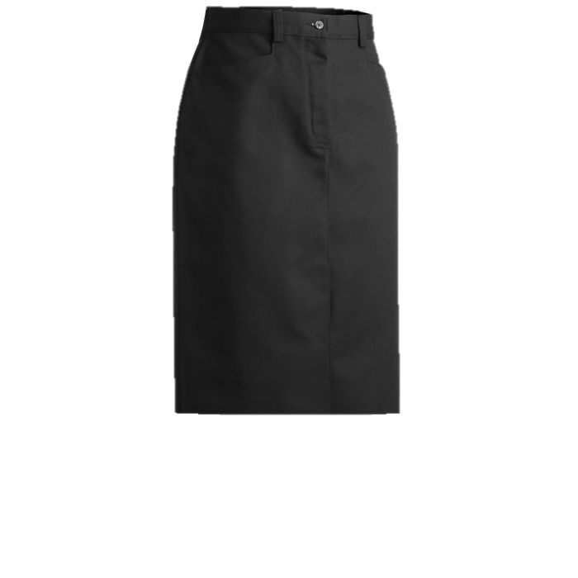
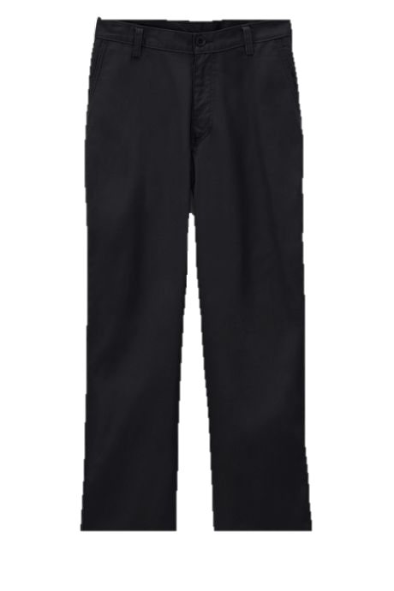
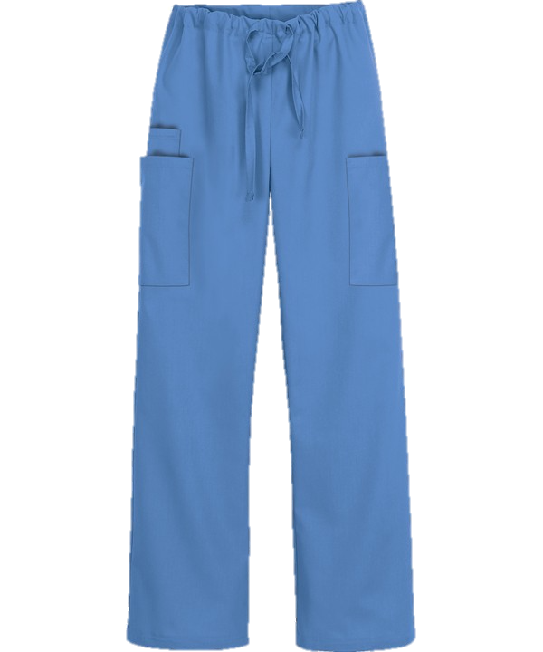
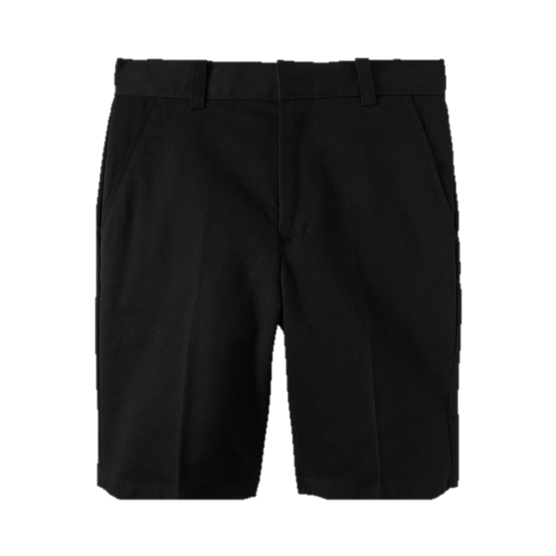
BOTTOMS
Employees may wear plain black bottoms or correlating smock and/or nursing bottoms:
  Skirts should be no shorter than knee length and no longer than ankle length
  Shorts should be fitted at the waist and should not be baggy nor too tight
  Pants must be fitted at the waist
  Bottoms should not be ripped
  Jeans permitted on Fridays

Slide 7
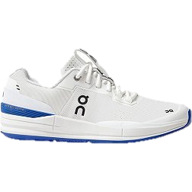
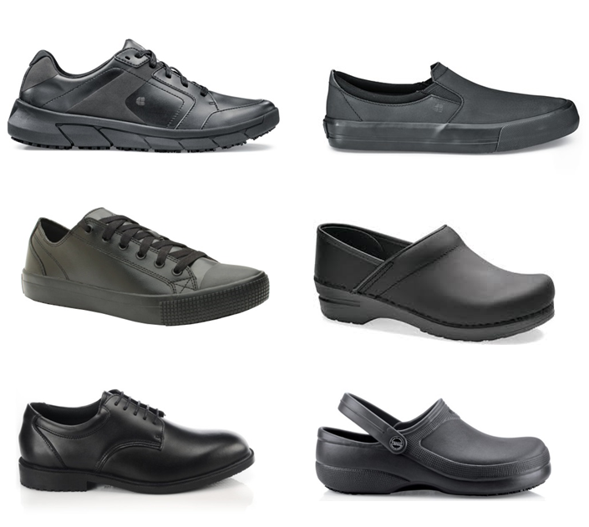

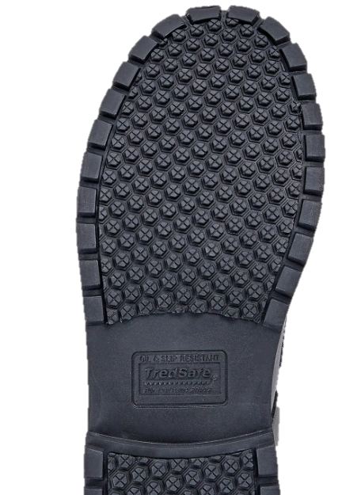
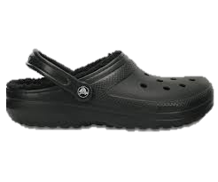

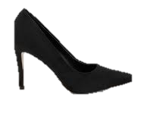
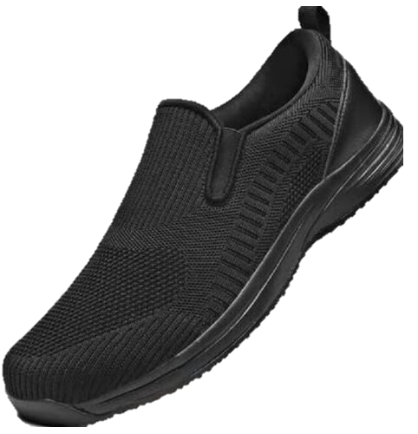
SHOES
Employees must wear comfortable, low or no-heel closed-toe shoes with slip-resistant soles and socks.
“SLIP-RESISTANT” marked on the sole
Shoes must be leather or leather-like
No absorbent material such as perforated mesh or canvas
Approved
Unapproved
Indicator

Slide 8

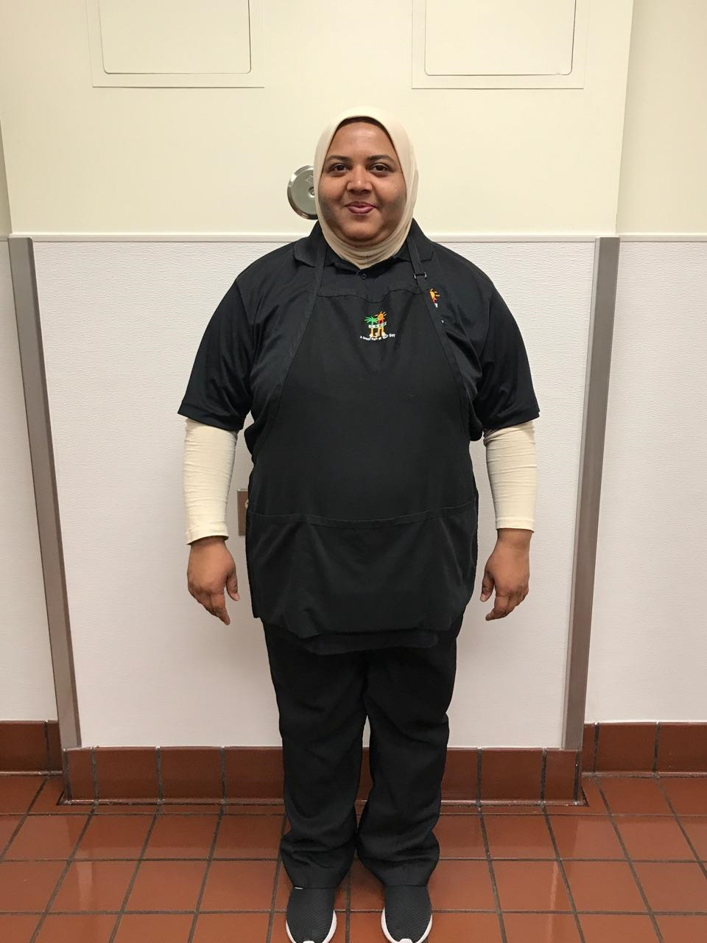
HAIR AND BEARD COVER
    Employees must always secure their hair utilizing approved:
Disposable hairnets
Disposable beard snood
Religious and/or ethnic head covering
Provided it does not pose a safety or sanitation concern
  Approved cap

Slide 9








PROHIBITED ITEMS
Food Service employees are prohibited from wearing:
False Eyelashes
False Nails
Nail Polish
Henna Tattoos
Face piercings
Wristwatch
Ring with stones and/or designs
One plain band ring is permitted.

Slide 10

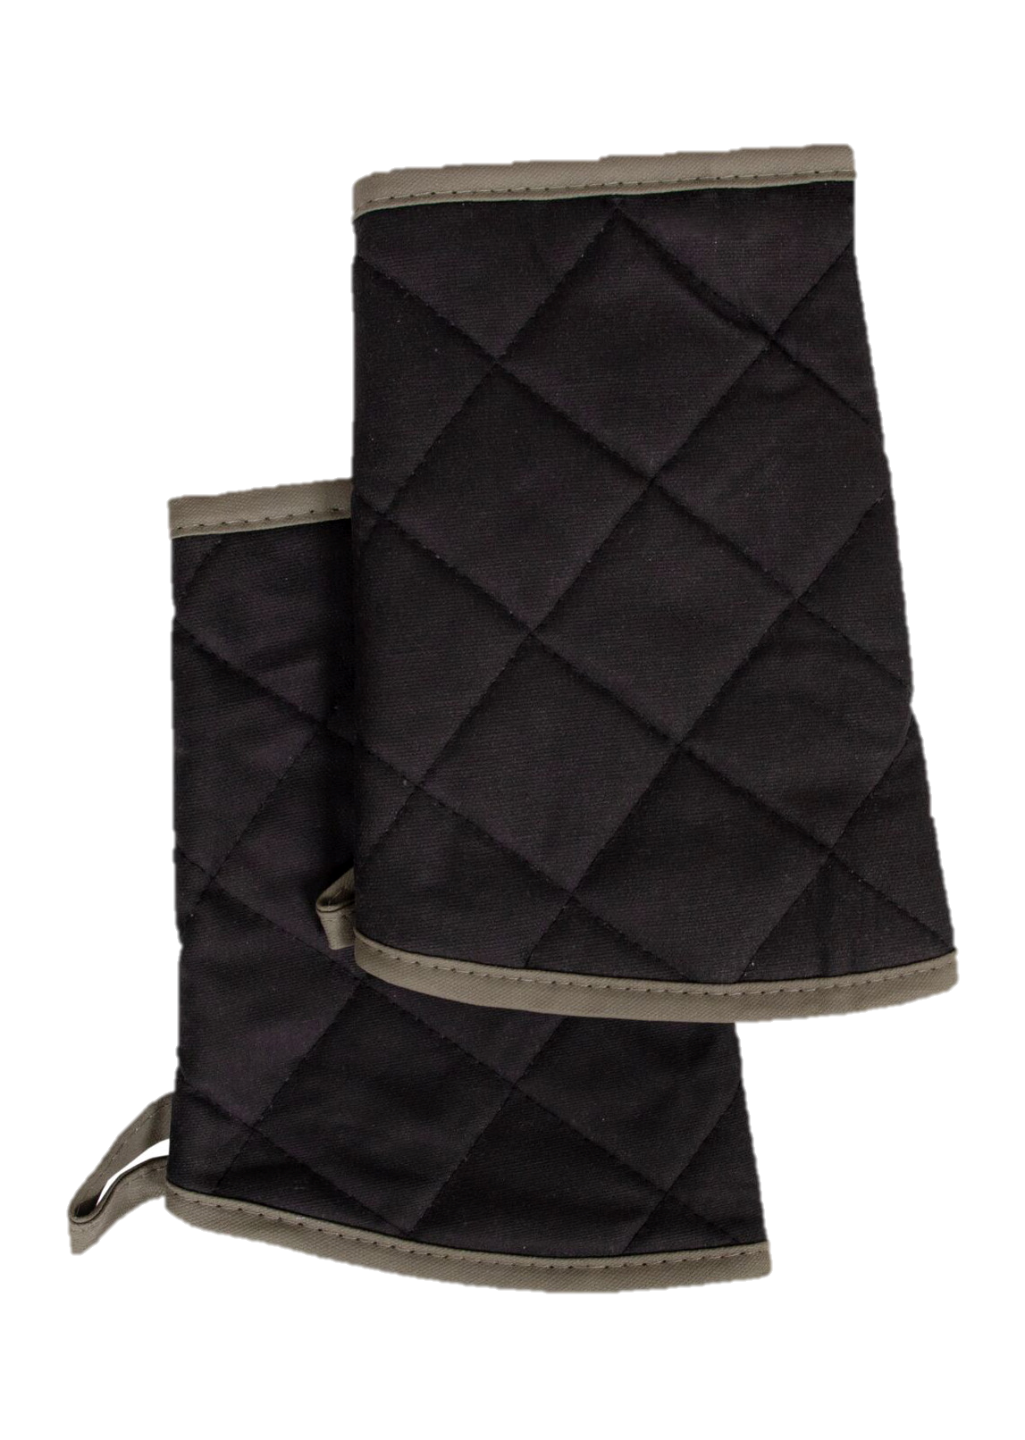


SAFETY REQUIREMENTS
Employees must adhere to safety requirements in school cafeterias and/or food production areas.
    Use required personal protective equipment (PPE)
        Oven mitts
        Oven sleeves
        Aprons
        Eye and/or face protection
        Food Services will provide cotton
        gloves upon arrival at each assignment.

Slide 11

SUBSTITUTES
Substitute Food Service workers are required to wear white polo, plain black pants, and slip-resistant shoes to every assignment.
Disposable hair nets, aprons and gloves will be provided by Food Services upon arrival at each assignment.
Substitutes must follow the prohibited items policy.

Slide 12


SANITATION AND PERSONAL HYGIENE

Slide 13

HANDWASHING
Employees must wash their hands, wrists, and arms for at least 20 seconds.
Examples:
Before beginning work
After handling money
After using the restroom
Before putting on gloves
After handling trash and boxes
After eating, drinking, and smoking

Slide 14
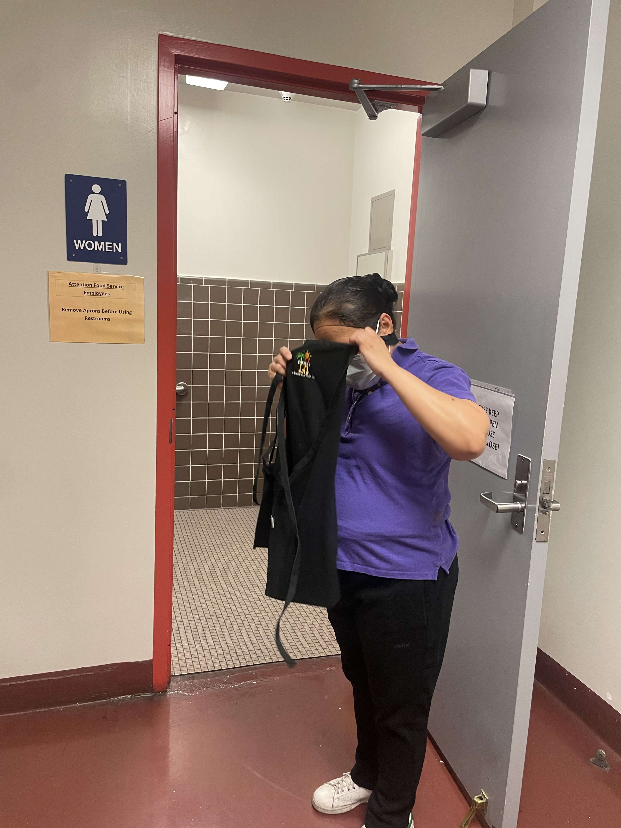
APRONS
        Aprons are to be worn to protect clothing from food, dirt, and bacteria. Do not use aprons to wipe soiled hands.
      Remove aprons when:
          Leaving the food preparation area
          On break and/or while eating lunch
          Using the restroom

Slide 15
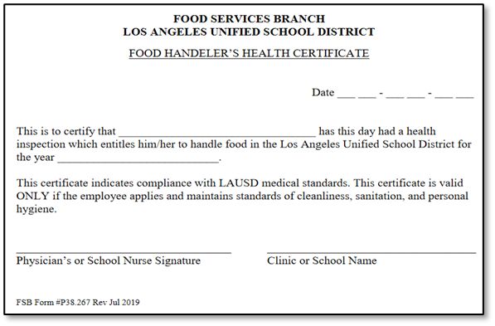

FOOD HANDLER’S CERTIFICATE &
SERVSAFE CERTIFICATE

Slide 16
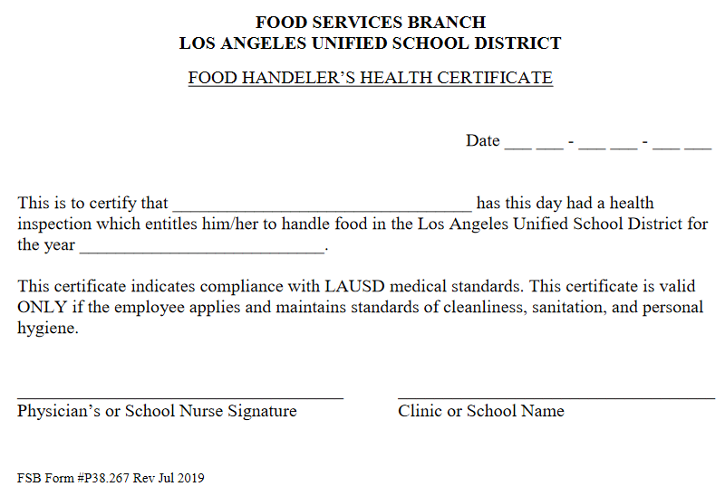
FOOD HANDLER’S CERTIFICATE
At the beginning of each school year, cafeteria/food production staff are required to obtain a Food Handler’s Health Certificate from the School Nurse.
After verifying all employees have obtained a certificate, Food Services Manager (FSM) will email a copy of the certificates to their Area Food Service Supervisor (AFSS). Post certificates in FSM’s office.

Slide 17

SERVSAFE CERTIFICATION
Food Services Division provides ServSafe classes and exams for the following positions that are required to maintain a valid Food Protection Manager Certification include:
Food Service Worker II
Senior Food Service Worker
Food Service Manager
Some Central Office staff
  Some Newman Nutrition Center staff
Food Protection Managers Certificates are accepted from Servsafe and authorized alternate agencies.

Slide 18

SERVSAFE RENEWAL
Failure to renew certification prior to expiration date may result in disciplinary action including, but not limited to, demotion or dismissal from District service.
Food Service Workers are not required to have a ServSafe certificate. However, ServSafe classes are available to Food Service Worker at their own expensive, utilizing benefited time.

Slide 19

CODE OF CONDUCT

Slide 20



CODE OF CONDUCT WITH STUDENTS
Employees who interact with students are expected to use good judgement when interacting with them. Food Service employees may not:
  Meet with any student privately
  Touch any student(s)
  Have physical contact with students
  Give or accept gifts from students
  Provide or ask for transportation

Slide 21

PHYSICAL CONTACT WITH STUDENTS
Food Services Employees may not attempt to discipline any student(s). This includes touching or having physical contact with students:
Body
Hands
Back
Hair
Backpack
Phones
Etc.

Slide 22


COMMUNICATING WITH STUDENTS
Food Service Division employees may not:
  Communicate with any student(s) via:
        Writing
        Personal cell or home phone
        Email
        Texting or messaging
        Internet
        Social media apps
        Online gaming

Slide 23

GRACE UNDER PRESSURE
Displaying grace under pressure is all about staying calm and mature in stressful or problematic situations
Suggestions on how to practice grace under pressure:
  Lead by example
  Take a deep breath
  Think positively
  Be proactive
  Focus on the big picture

Slide 24

SELF CONTROL
Remember you cannot control other people's actions, but you have complete control of your own reactions.

Slide 25



ELECTRONIC DEVICES
    Employees cannot use electronic devices for personal reasons during scheduled work hours.
    Cell phones, tablets, and any wireless devices must be secured in a safe place away from the work area
    No personal telephone calls, except during their assigned break or lunch time
    Cafeteria phones are not to be used for personal use

Slide 26

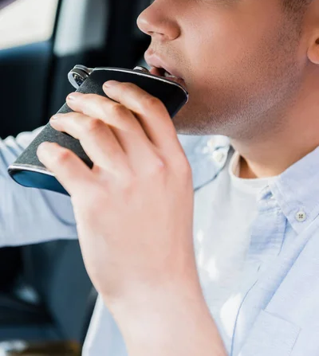

DRUG, ALCOHOL AND TOBACCO POLICY

Slide 27
DRUG AND ALCOHOL POLICY
The District maintains a drug and alcohol-free workplace.
Employees are prohibited from using drugs or alcohol on any District property, while at work, or at any District-sponsored event.
There is zero tolerance for possession or being under the influence of drugs or alcohol.

Slide 28
TOBACCO FREE WORKPLACE
The District policy prohibits smoking and the use of all tobacco products, including cigarettes, cigars, e-cigarettes, and related paraphernalia, on all District property and within 100 yards of school campus, including:
  Campus
  Sidewalks
  Parking lots
  District vehicles
  District-owned or leased
  buildings

Slide 29
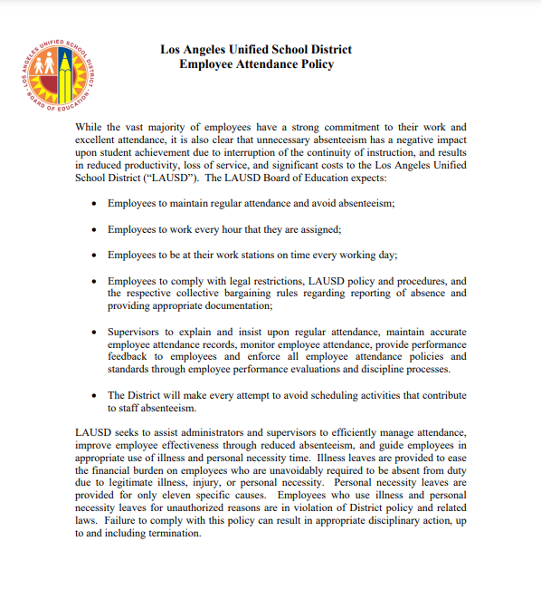
ATTENDANCE EXPECTATIONS

Slide 30
ATTENDANCE EXPECTATIONS
The contribution of each Food Services Division and District employee is critical to the efforts of reaching goals.
Most employees have a strong commitment to their work and excellent attendance records.
Unnecessary absenteeism results in:
Reduced productivity
Loss of service
Significant costs to the Division and District

Slide 31
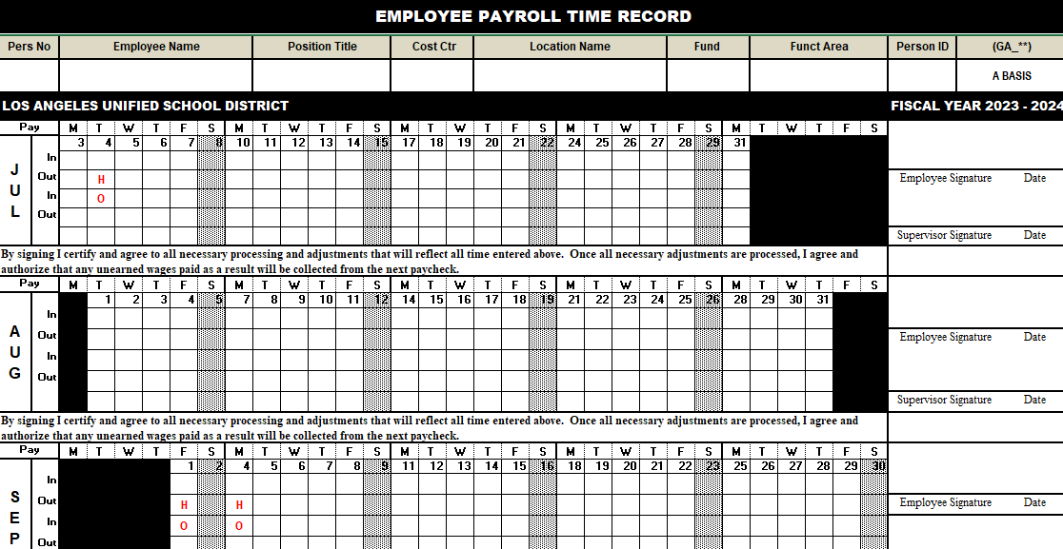
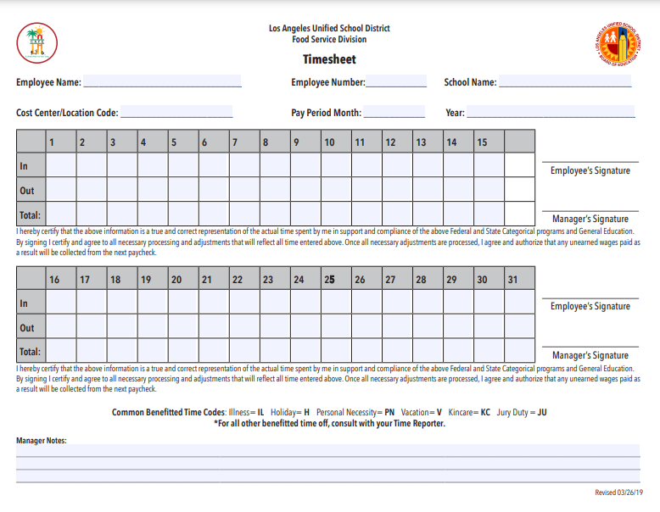
TIMEKEEPING
Employees' work hours and absences must be documented by hand daily on their timesheets and timecards.

Slide 32

WHEN CALLING IN ABSENT
A school-based Food Services employee must report absences no later than two (2) hours before the start of his/her shift for the FSM/AFSS or immediate supervisor to obtain coverage for that day.

Slide 33
RETURN TO WORK
All Food Service employees must personally contact their immediate supervisor on each day of absence, unless they are placed on an extended leave of absence.
If an employee is absent for more than five (5) consecutive workdays:
    A school nurse or district doctor must see the employee and must be cleared before returning to work
    Employee must submit documentation of the absence upon their return to work
    Employees must provide a doctors upon their return to work.

Slide 34
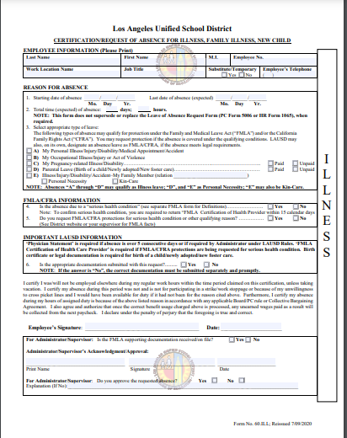
ILLNESS
Employees must report their absences daily unless their healthcare provider has placed them on documented absences or extended leave.
Complete the Certification/Request of Absence for Illness, Family Illness, New Child form for all illness related absences.

Slide 35




KIN CARE
Kin Care is deducted from accrued full-pay illness.
Employees are granted six (6) days of protected Kin Care each calendar year from January-December for an ill family member. This includes:
Parent
Child
Spouse
Registered Domestic Partner
In-laws
Live in relatives and other qualifying members

Slide 36
NON-ILLNESS
    Personal Necessity must be approved before it is taken.
    FSM and AFSS may ask additional clarifying questions to determine if an absence qualifies as personal necessity.
Complete the Certification/Request of Absence for Non-Illness Form for all non-illness-related absences. This includes;
Personal Necessity
Vacation
Paid Parental Leave

Slide 37

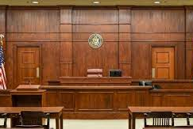
PROTECTED PERSONAL NECESSITY
Personal Necessity (PN) seven (7) days is deducted from accrued Full Pay Illness and time must be approved prior to being taken.
Personal Necessity seven (7) days per fiscal year (July – June).
Protected Absences
Religious Holiday of the Employee’s Faith
Appearance in Court as a Litigant or
Witness Under Subpoena
School Activities

Slide 38
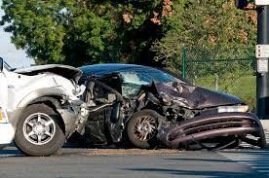
UNPROTECTED PERSONAL NECESSITY
Unprotected Absences
Accident involving staff person or property
Imminent danger to home due to disaster
Other significant event of a compelling nature to the employee
One day for taking registration or final exam in District recognized institutions of higher learning
Refer to FSD Handbook page 41 for further clarification

Slide 39

EXCESSIVE ABSENTEEISM
Employees with excessive absenteeism will be documented and may face disciplinary action.
Examples and patterns of excessive absenteeism include:
  Frequent or short-term absences
  Before or after a holiday
  Absences on Monday or Friday
  Before or after disciplinary action
  Before Scheduled assigned task
  After a vacation request is denied
  Before or after vacation

Slide 40
PROBATIONARY PERIOD
Preliminary Evaluation
Complete within two months of the employee’s start date
Be sure to document performance issues not just when completing the Performance Evaluations
Cannot select “Not Passing” box on the Preliminary Evaluation. Can only be done on Final Evaluation
Final Evaluation
Complete no later than four months after the employee start date. It may be completed sooner
No more than six (6) days absent are allowed during the initial 130 working days probationary period.

Slide 41
WORKER’S COMPENSATION
If an employee becomes injured on the job, it is the
employee’s responsibility to:
  Report any work-related injury to the Food Service Manager immediately
  Complete Worker’s Compensation Claim Form (DWC-1)
  Obtain Medical Authorization or complete a Claim Withdrawal Form if you choose not to file a claim
  Return to work after treatment and forward the original source or PDF format Work Status Report to the Food Service Manager and their assigned HR
  Include witness statements

Slide 42

WORKER’S COMPENSATION
Medical Provider Networks (MPN) are a network of clinics developed by Sedgwick. The goal of the MPN is to help ensure injured employees receive quality medical care.
For initial treatment, all employees must utilize a clinic in the MPN.
Do not use MPN for return-to-work Health Appraisals.

Slide 43
EMPLOYEES PROTECTED LEAVES
The Family Medical Leave Act (FMLA) and California Family Rights Act (CFRA) are statues that requires the District to provide eligible employees protected leave.
  Family Medical Leave Act (FMLA)
    Up to 12 work weeks
  California Family Rights Act (CFRA)
      Up to 12 work weeks
  California Pregnancy Disability Leave (PDL)
      Up to 18 work weeks
  Military Exigency
      Up to 26 work weeks

Slide 44
FMLA AND CFRA ELIGIBILITY
Employees are eligible if they:
      Have been employed for at least 12 months
      Have worked 130 days in a 12-month period
Reasons for FMLA:
Employee’s own serious health condition
Family member’s serious health condition
Spouse, parent, child under the age of 18, registered
domestic partner’s serious health condition
    Birth of an employee’s child
    Child adoption or foster care
    Condition related to pregnancy and/or childbirth

Slide 45
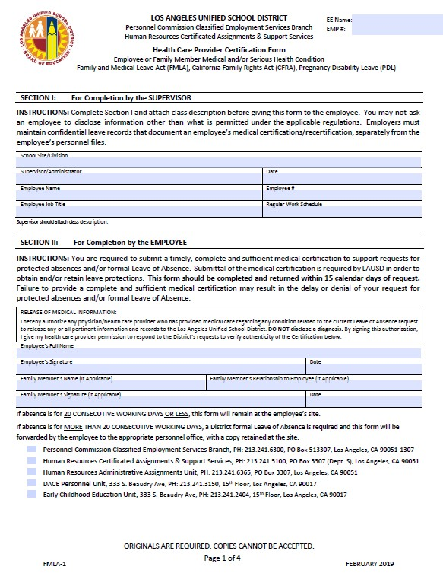
HEALTHCARE PROVIDER CERTIFICATION FORM
Employees requesting FMLA must submit a completed 4-page Health Care Provider Certification to the immediate supervisor and copy your HR Representative.
HR process FMLA. SAA does not process FMLA for Food Service Employees.

Slide 46
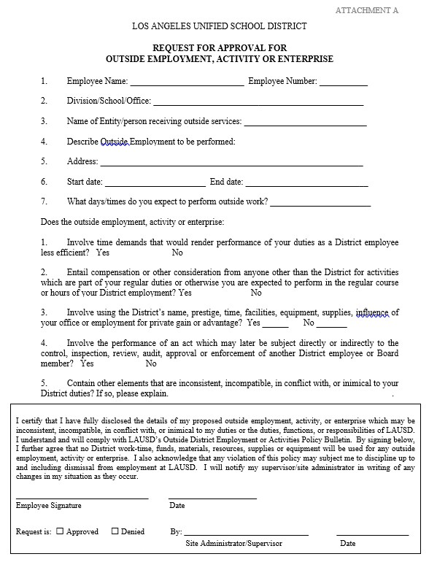
EMPLOYMENT OUTSIDE DISTRICT –
ACTIVITY OR ENTERPRISE
Employees who have outside employment and other activities which may interfere with District work, are legally required to disclose such activities.
Permission must be requested:
Before engaging with outside work
Continuing to engage if not previously disclosed
Employees must submit the “Request for
Approval for Outside Employment,
Activity, or Enterprise” form to AFSS.

Slide 47
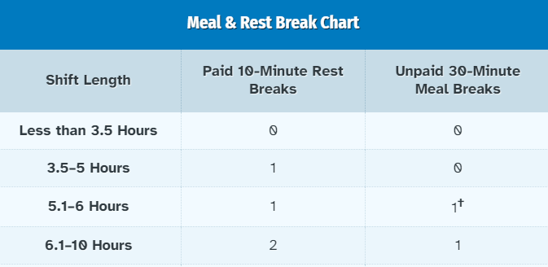
WORK SCHEDULES AND BREAKS
California law requires mandatory rest/meal periods.
Rest Period (paid)
Four (4) hours—one ten (10) min. break
Five (5) hours—one ten (10) min. break
Six (6) hours– two ten (10) min. breaks
May not be used to shorten the day
Meal Period (unpaid)
Five ½ (5.5)-hour or greater–one (30) min. meal
Do not schedule rest and/or meal periods during the first or last hour of the employee’s shift.

Slide 48
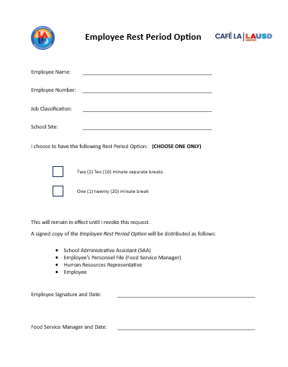
WORK SCHEDULES AND BREAKS
Employees have the option to choose their rest period.
Employees Complete Information
Employee Name
Employee Number
Job Classification
School Site
Employees choose option
Employee Rest Period Option
Two (2) Ten (10)-minute breaks
One (1) twenty (20) minute break
Distribute copies
SAA
Employee file (FSM)
HR Representative
Employee
Refer to FSD Handbook pages 36-37 for further clarification

Slide 49
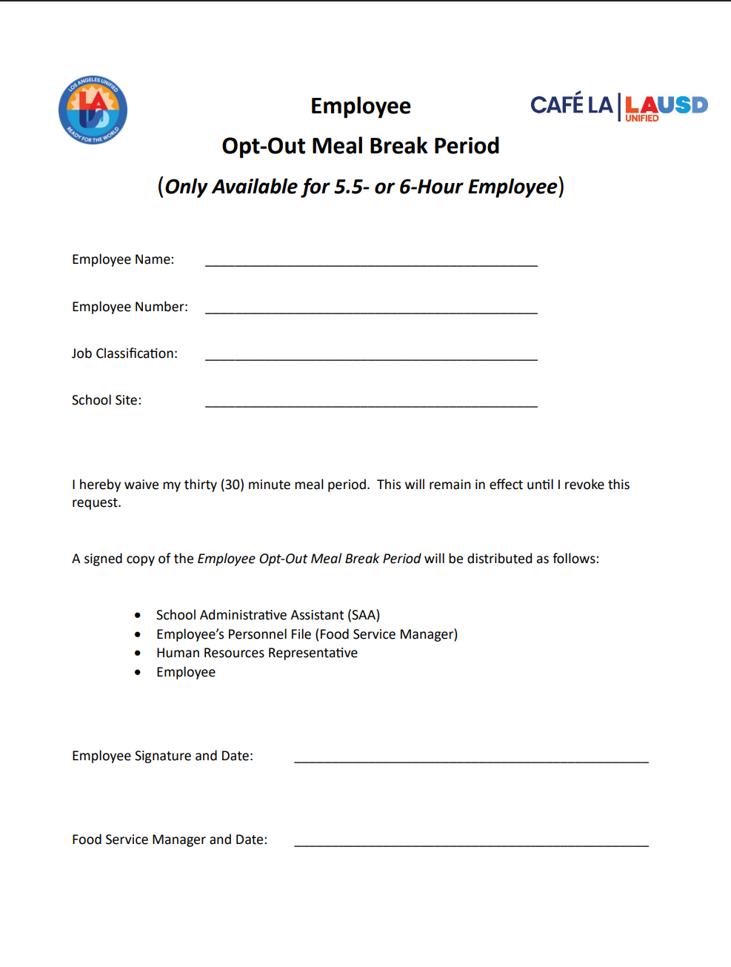
EMPLOYEES HAVE THE OPTION TO
OPT-OUT OF THEIR REST PERIOD
Employees Complete Information
Employee Name
Employee Number
Job Classification
School Site
Employee
opt – Out
Meal Break
Only applies to 5.5 or 6.5 hour
Distribute copies
SAA
Employee file (FSM)
HR Representative
Employee

Slide 50

REST/MEAL PERIODS
Breaks are paid by the District, and employees are to remain on company property.
Meal periods are unpaid and are the employee’s personal time.
Employees may leave the property on their personal time but must return to work on time.
If a FSW or FSM is leaving the school site for their meal period, the FSM must notify both the AFSS and the Principal.
Refer to FSD Handbook pages 36-37 for further clarification

Slide 51

PROFESSIONAL STANDARDS REQUIREMENT

Slide 52

PROFESSIONAL STANDARDS
    Professional Standards requirements ensure school nutrition personnel have the knowledge, training, and tools needed to prepare nutritious, safe, and enjoyable school meals.
Training topics depend on job requirements and are notified via email upon registration in MyPLN.

Slide 53
PROFESSIONAL STANDARDS REQUIREMENTS
The Food Service Manager is required to monitor their
cafeteria staff’s Professional Standards completion
status.
Provide time during employee-assigned work hours
Follow the training brochure to confirm all training is complete
    To access and complete the assigned Professional Standards training, login utilizing LAUSD single sign-on

Slide 54
REQUIRED TRAINING HOURS
BY JOB CLASS
FOOD SERVICE MANAGER
10 HOURS
SENIOR AND FOOD SERVICE WORKER
6 HOURS
SUBSTITUTE FOOD SERVICE WORKER
4 HOURS
REGIONAL MANAGER
12 HOURS
SUPERVISOR
10 HOURS
DIRECTOR
12 HOURS

Slide 55
Newly hired FSWs and sub-FSWs are mandated to attend the Food Services Division New Employee Training (NET).
The 3-day training program is conducted by FSD.
NET is to be completed no later than 3 months after the employee’s date of hire.
FOOD SERVICES NEW EMPLOYEE TRAINING
NEW EMPLOYEE ORIENTATION (LAUSD/SEIU)
Each newly hired regular district employee in SEIU- represented classes will be required to attend a new employee orientation conducted by the district, no later than 30 working days after the employee's date of hire.

Slide 56

PROFESSIONAL BEHAVIOR
IN THE WORKPLACE

Slide 57



PROFESSIONAL BEHAVIOR IN THE WORKPLACE
Professionalism in the workplace refers to an employee’s conduct. Be respectful to others when interacting with coworkers, school-based staff, parents, and students.
Do not use profanity
Do not engage in gossip
Keep conversations appropriate for a
school environment
Be mindful of gestures and body language

Slide 58

SEXUAL HARASSMENT
Any act of sexual harassment is a violation of state and federal laws and is prohibited per District policy. This includes any unwelcome conduct that is:
    Verbal
    Visual
    Physical
Retaliation is prohibited against anyone who files a sexual harassment complaint or who participates in the complaint investigation process.

Slide 59
HANDBOOK RESPONSIBILITY

Slide 60
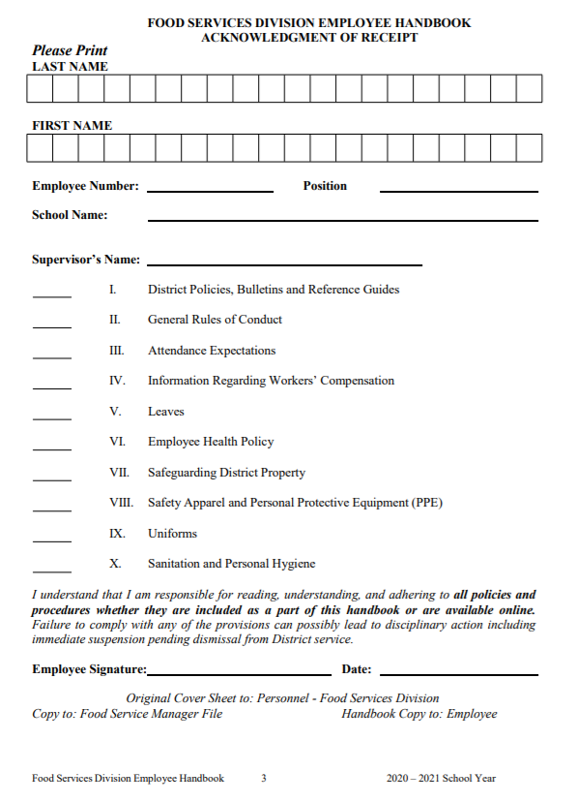
ACKNOWLEDGMENT OF RECEIPT
All FSD employees are required to read the Food Services Division Employee Handbook.
Submit a signed Acknowledgement of Receipt to their immediate supervisor.
Maintain the original in the employee’s personal file.

Slide 61
HANDBOOK REVIEW
Immediate supervisor are required to review the FSD handbook and addendum with their staff and enforce all policies and procedures.

Slide 62


EMPLOYEE UNIONS
    Employees may discuss union/association issues with a representative outside of their work duties this includes;
Preceding the daily period of service
Following the close of the daily period of service
During the employee's duty-free lunch period

Slide 63
HUMAN RESOURCES (HR) TEAM
Richard Zavala HR Branch Manager richard.zavala@lausd.net
South Region -Valerie Bell
valerie.bell@lausd.net
East Region- Babatu Hansen
babatu.hansen@lausd.net
West Region - Judith Garcia
judith.garcia1@lausd.net
North Region - Regina Cooks
regina.cooks@lausd.net

